Slide 1
NETWORK LAYER

Slide 2
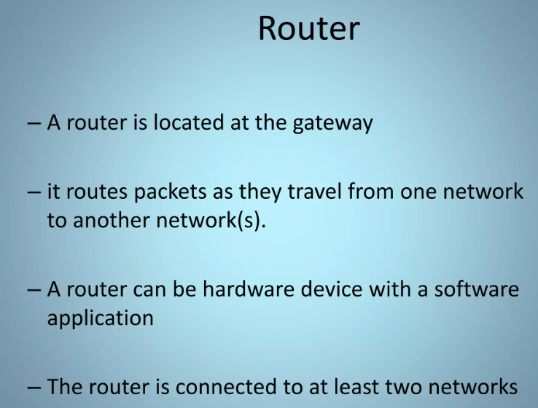

Slide 3
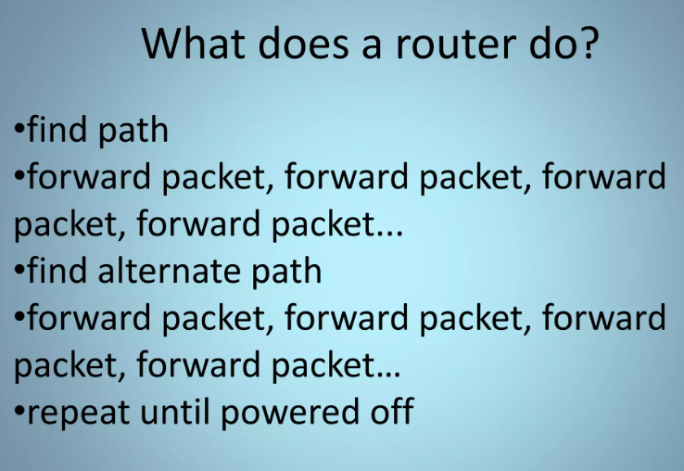

Slide 4
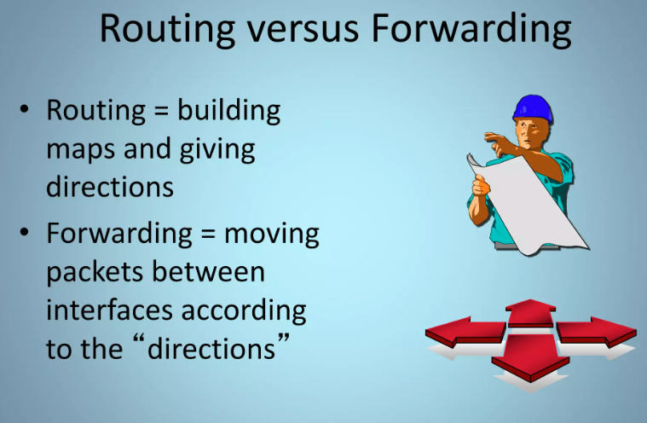

Slide 5
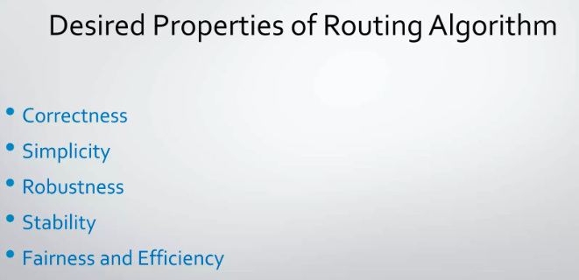

Slide 6
ROUTING ALGORITHMS
The part of the Network Layer responsible for deciding on which output line to transmit an incoming packet.
If the network uses datagrams internally, this decision must be made a new for every arriving data packet since the best route may have changed since last time.
If the network uses virtual circuits internally, routing decisions are made only when a new virtual circuit is being set up.
Thereafter, data packets just follow the already established route.
The latter case is sometimes called session routing because a route remains in force for an entire session (e.g., while logged in over a VPN).
It is sometimes useful to make a distinction between routing, which is making the decision which routes to use, and forwarding, which is what happens when a packet arrives.
A router as having two processes inside it.
One of them handles each packet as it arrives, looking up the outgoing line to use for it in the routing tables. This process is forwarding.
The other process is responsible for filling in and updating the routing tables.
Algorithm properties
correctness, simplicity, robustness, stability, fairness, optimality and scalability.

Slide 7
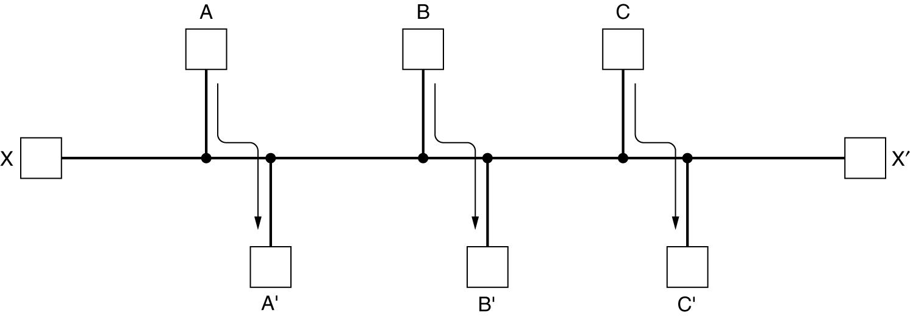
Fairness and efficiency may sound traffic between A and A′, between B and B′, and between C and C′ to saturate the horizontal links.
To maximize the total flow, the X to X′ traffic should be shut off altogether. Unfortunately, X and X′ may not see it that way. Evidently, some compromise between global efficiency and fairness to individual connections is
needed.
Minimizing the mean packet delay is an obvious candidate to send traffic through the network effectively, but so is maximizing total network throughput.
Conflict between fairness and optimality.

Slide 8
Routing algorithms
nonadaptive
adaptive
Non-Adaptive Routing
Adaptive Routing
routing computed in advance
and off-line
Flooding
static routing using shortest path algorithms
it does not respond to failures
Static routing is mostly useful for situations in which the routing choice is clear
based on current measurements
of traffic and/or topology.
centralized isolated Distributed
Dynamic Routing
Change their routing decisions to reflect changes in the topology, and sometimes changes in the traffic as well.

Slide 9
Routing Algorithms
The Optimality Principle
Shortest Path Routing
Flooding
Distance Vector Routing
Link State Routing
Hierarchical Routing

Slide 10
Optimality Principle
optimality principle (Bellman, 1957).
It states that if router J is on the optimal path from router I to router K,
then the optimal path from J to K also falls along the same route.
To see this, call the part of the route from I to J r1 and the rest of the route
r 2.
If a route better than r 2 existed from J to K, it could be concatenated with r 1 to improve the route from I to K, contradicting our statement that r 1r 2 is optimal.
The set of optimal routes from all sources to a given destination form a tree rooted at the destination. Such a tree is called a sink tree.

Slide 11
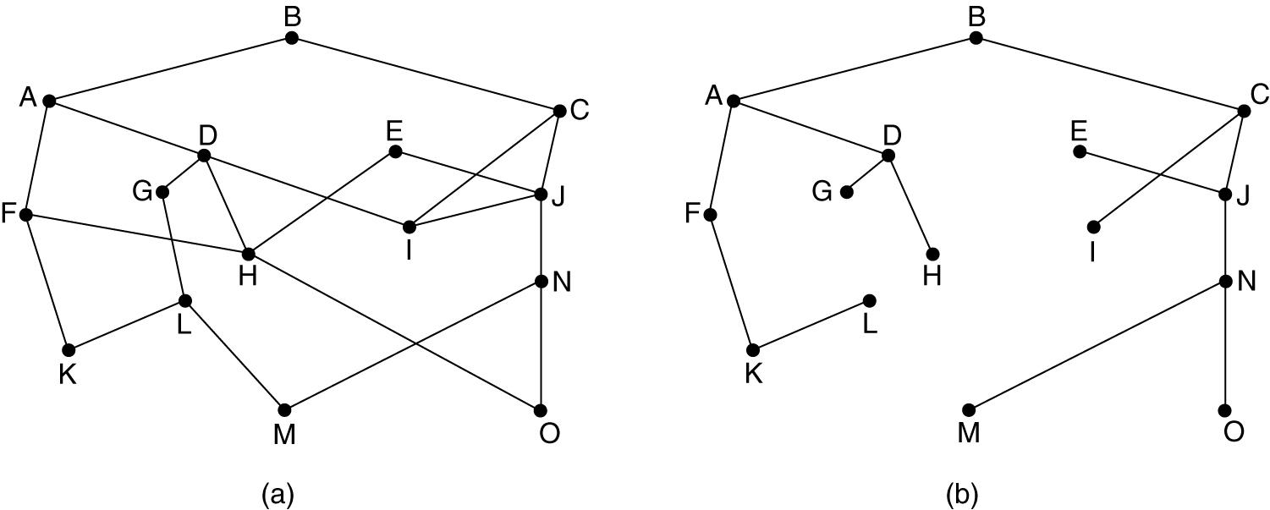
Figure 5-6. (a) A network. (b) A sink tree for router B.
DAG (Directed Acyclic Graph)
DAGshave no loops. We will use sink trees as a convenient shorthand for both cases.
Both cases also depend on the technical assumption that the paths do not interfere with each other so, for example, a traffic jam on one path will not cause another path to divert.
Since a sink tree is indeed a tree, it does not contain any loops, so each packet will be delivered within a finite and bounded number of hops.

Slide 12
Shortest Path Algorithm
A graph of the network, with each node of the graph representing a router and each edge of the graph representing a communication line, or link.
To choose a route between a given pair of routers, the algorithm just finds the shortest path between them on the graph.
The concept of a shortest path deserves some explanation.
One way of measuring path length is the number of hops.
Using this metric, the paths ABC and ABE in Fig. are equally long.
Another metric is the geographic distance in kilometers, in which case ABC is clearly much longer than ABE (assuming the figure is drawn to scale).

Slide 13
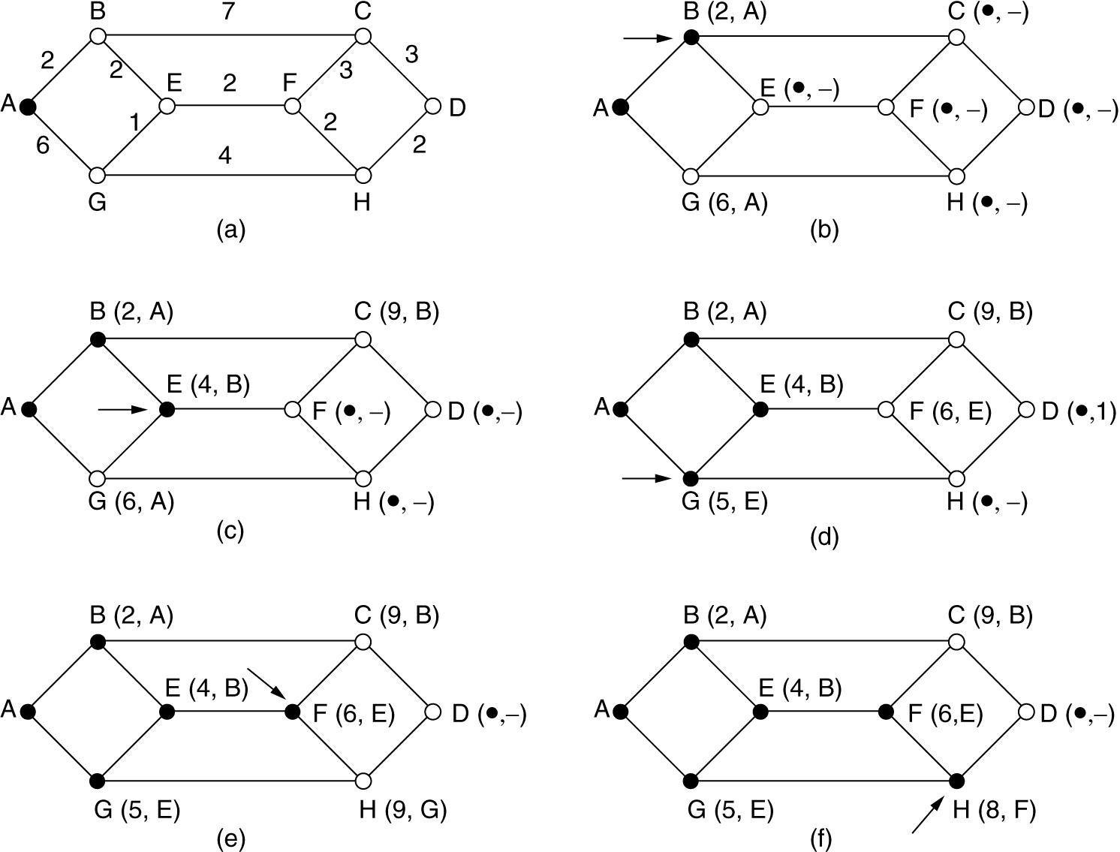
The first six steps used in computing the shortest path from A
to D.
The arrows indicate the working node.

Slide 14
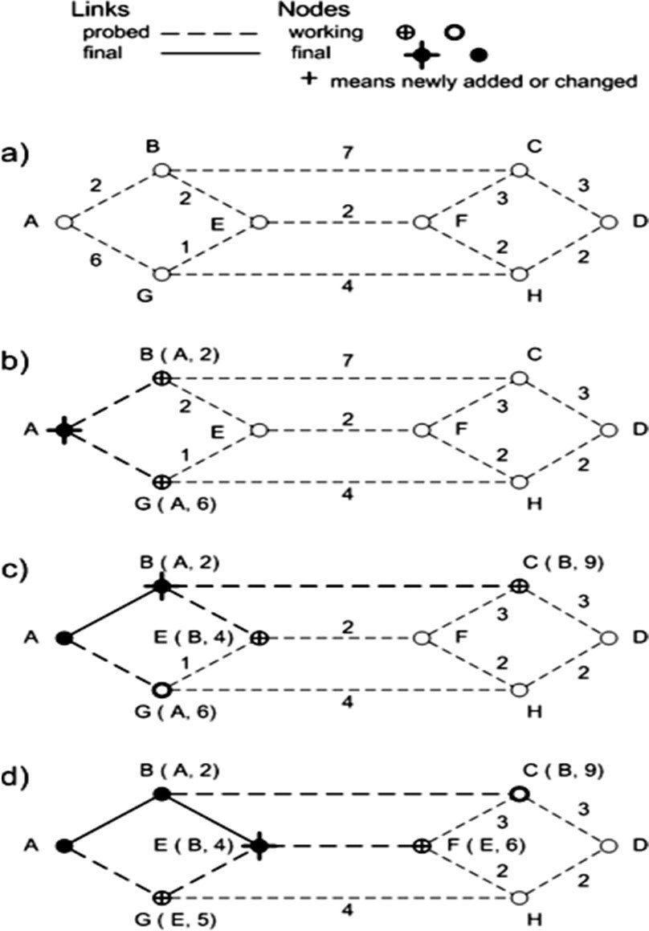
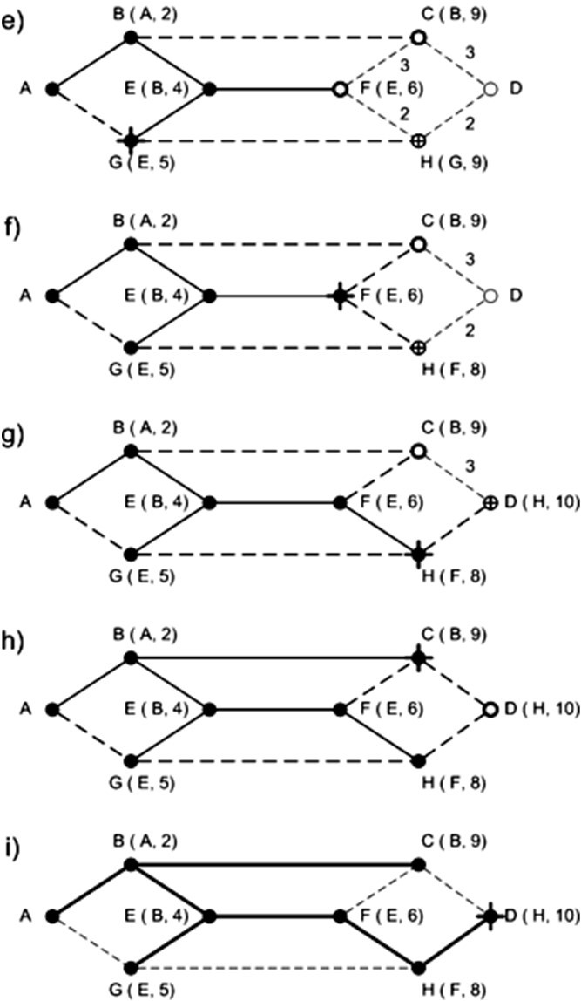
Steps followed in obtaining shortest path from node A to node D

Slide 15
Flooding
When a routing algorithm is implemented, each router must make decisions based on local knowledge, not the complete picture of the network.
A simple local technique is flooding, in which every incoming packet is sent out on every outgoing line except the one it arrived on.
Flooding obviously generates vast numbers of duplicate packets, in fact,
an infinite number unless some measures are taken to damp the process.
One such measure is to have a hop counter contained in the header of each packet that is decremented at each hop, with the packet being discarded when the counter reaches zero.
Ideally, the hop counter should be initialized to the length of the path
from source to destination.

Slide 16
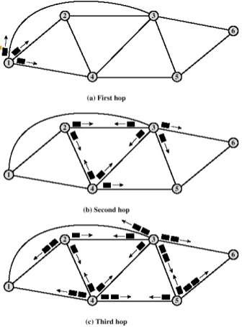
FLOODING
Selective Flooding: A variation of flooding that is slightly more practical is selective flooding. In this algorithm the routers do not send every incoming packet out on every line, but only on those lines that are going approximately in the right direction for e.g. a westbound packet is sent on a

Slide 17
Properties of Flooding
All possible routes are tried
Very robust
Can be used for emergency messaging
At least one packet will use minimum hop count route
Can be used once to set up a route
All nodes are visited
Useful to distribute information (e.g. routing table)
Advantages of Flooding:
Flooding provides robustness in the sense that all alternative paths between different nodes are covered by a packet, which may be highly desirable in some applications like military.
In distributed database applications, it is sometimes necessary to update all the databases concurrently; in which case flooding can be useful.
Flooding always chooses the shortest path, because it chooses every possible path in parallel.

Slide 18
Distance Vector Routing
Computer networks generally use dynamic routing algorithms that are more complex than flooding, but more efficient because they find shortest paths for the current topology.
Two dynamic algorithms in particular, distance vector routing and link state routing, are the most popular.
A distance vector routing algorithm operates by having each router maintain a table (i.e., a vector) giving the best known distance to each destination and which link to use to get there.
These tables are updated by exchanging information with the neighbors. Eventually, every router knows the best link to reach each destination.
The distance vector routing algorithm is sometimes called by other names, most commonly the distributed Bellman-Ford routing algorithm, after the researchers who developed it (Bellman, 1957; and Ford and Fulkerson, 1962).
It was the original ARPANET routing algorithm and was also used in the Internet under the name RIP.

Slide 19
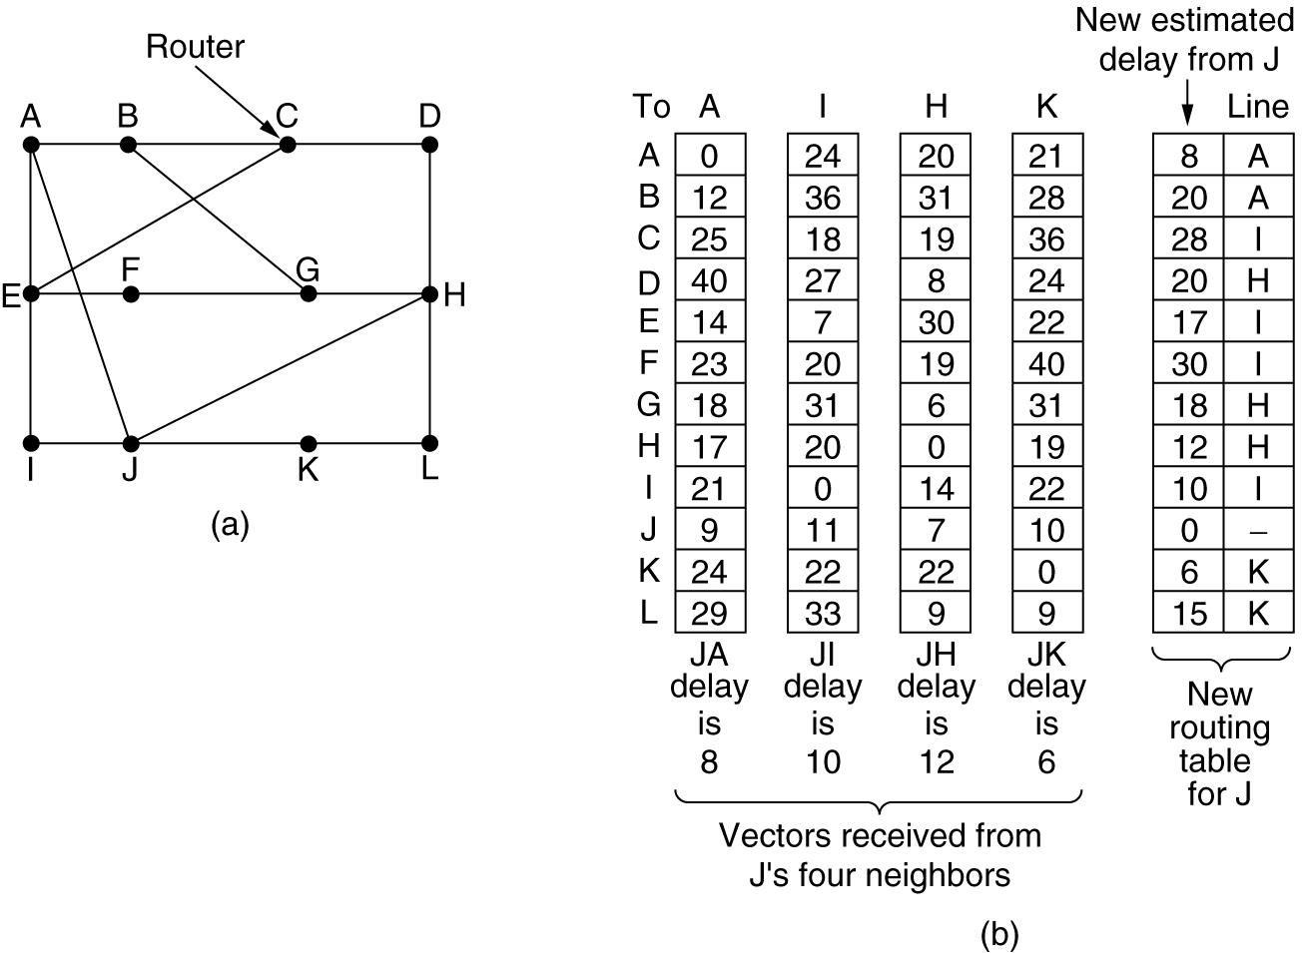
(a) A network. (b) Input from A, I, H, K, and the new routing
table for J.

Slide 20
Routing: distance vector
Algorithm
At each step within a router:
Get routing tables from neighbours
Compute distance to neighbours
Compute new routing table
Characteristics:
Iterative
Asynchronous
Distributed

Slide 21
The Count-to-Infinity Problem
The settling of routes to best paths across the network is called
convergence.
Distance vector routing is useful as a simple technique by which routers can collectively compute shortest paths, but it has a serious drawback in practice:
although it converges to the correct answer, it may do so slowly.
Drawback
Consider a router whose best route to destination X is long.
If, on the next exchange, neighbor A suddenly reports a short delay to X, the router just switches over to using the line to A to send traffic to X.

Slide 22
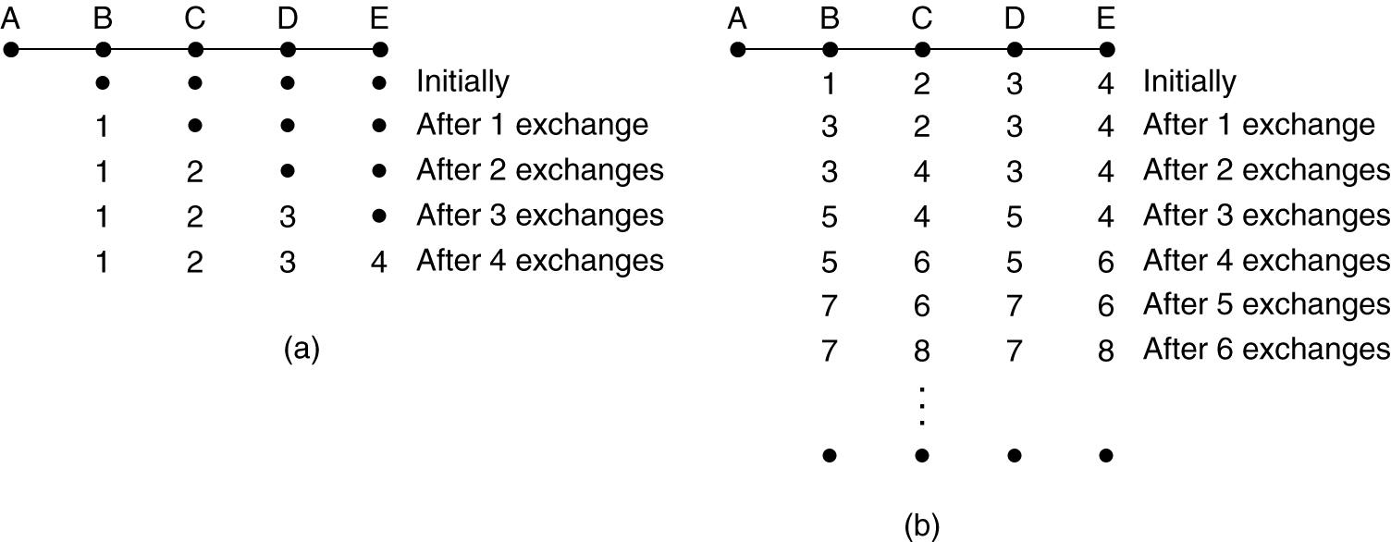
Advantage
consider the five-node (linear) network
of Fig. 5-10, where the delay metric is the number of hops. Suppose A is down initially and all the other routers know this. In other words, they have all recorded the delay to A as infinity.
The count-to-infinity problem.

Slide 23
Hierarchical Routing
As networks grow in size, the router routing tables grow proportionally.
Not only is router memory consumed by ever-increasing tables, but more CPU time is needed to scan them and more bandwidth is needed to send status reports about them.
At a certain point, the network may grow to the point where it is no longer feasible for every router to have an entry for every other router, so the routing will have to be done hierarchically, as it is in the telephone network.
When hierarchical routing is used, the routers are divided into regions.
Each router knows all the details about how to route packets to destinations within its own region but knows nothing about the internal structure of other regions.
When different networks are interconnected, it is natural to regard each one as a separate region to free the routers in one network from having to know the topological structure of the other ones.
For huge networks, a two-level hierarchy may be insufficient; it may be necessary to group the regions into clusters, the clusters into zones, the zones into groups, and so on, until we run out of names for aggregations.
The Berkeley router would know the detailed topology within California but would send all out-of-state traffic to the Los Angeles router.

Slide 24
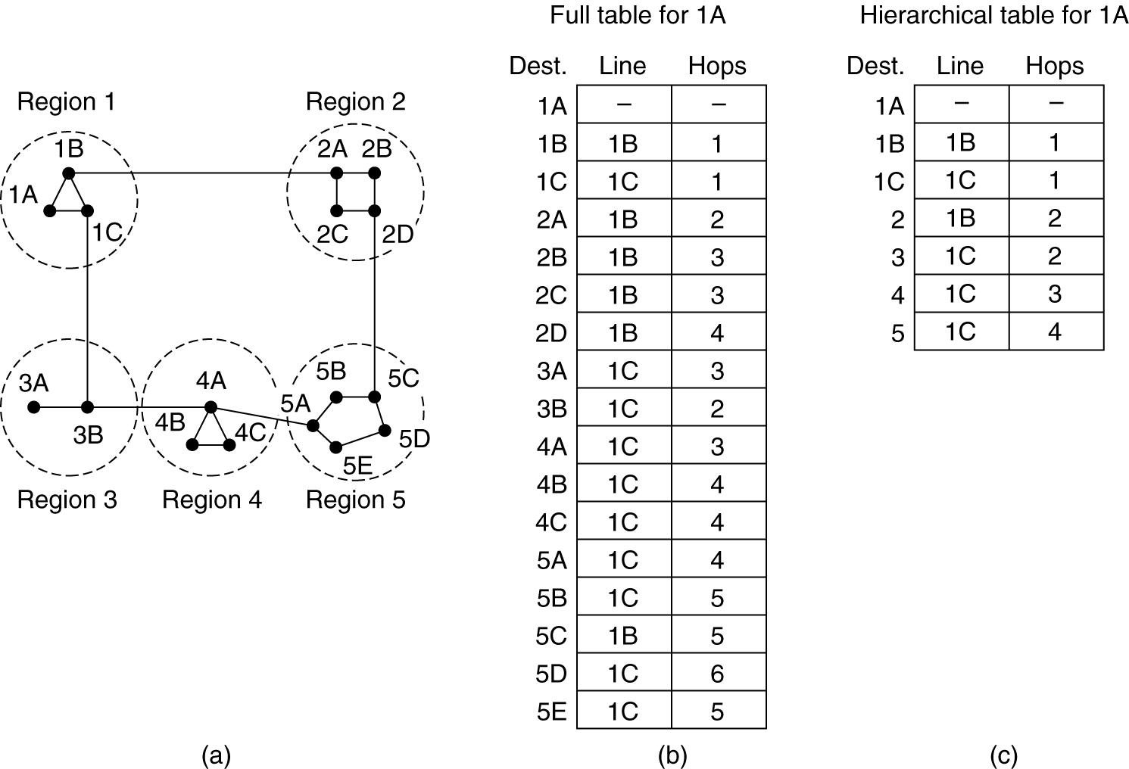
Hierarchical routing.

Slide 25
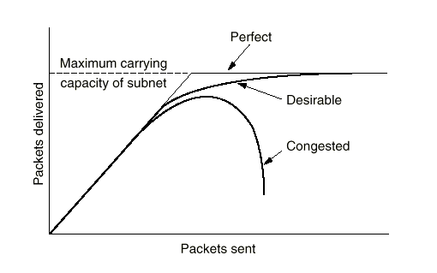
Congestion Control Algorithms
Congestion is a situation in Communication Networks in which too many packets are present in a part of the subnet, performance degrades. Congestion in a network may occur when the load on the network (i.e. the number of packets sent to the network) is greater than the capacity of the network (i.e. the number of packets a network can handle.)

Slide 26
Causes of Congestion
Congestion occurs when a router receives data faster than it can send it
Insufficient bandwidth
Slow hosts
Data simultaneously arriving from multiple lines destined for the same outgoing line.
The system is not balanced
Correcting the problem at one router will probably just move the bottleneck to another router.

Slide 27
Congestion Control Vs Flow Control
Flow control
controls point-to-point traffic between sender and receiver
e.g., a fast host sending to a slow host
Congestion Control
controls the traffic throughout the network

Slide 28
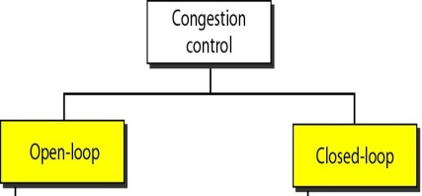
Two Categories of Congestion Control
Open loop solutions
Attempt to prevent problems rather than correct them
Does not utilize runtime feedback from the system
Closed loop solutions
Uses feedback (measurements of system performance) to make corrections at runtime.

Slide 29
General Principles of Closed Loop Congestion Control
Monitor the system to detect when and where congestion occurs.
Pass this information to places where action can be taken.
Adjust the system operation to correct the problem.

Slide 30
Metrics Used in Closed Loop Congestion Control
Percentage of packets discarded due to buffer overflow
Average queue length
Percentage of packets that time-out
Average packet delay
Standard deviation of packet delay

Slide 31
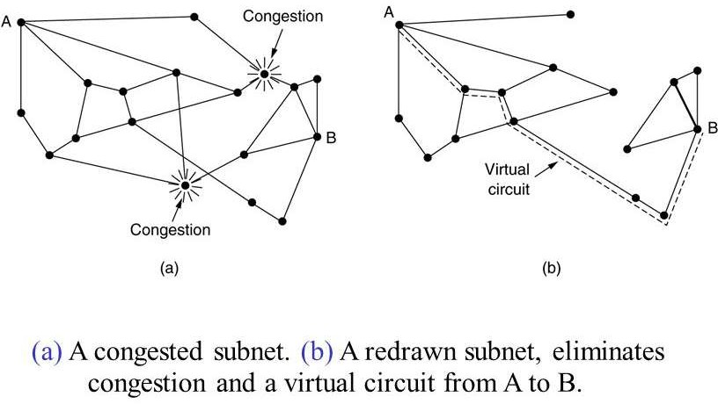
Congestion control in Virtual – Circuit Subnets
One technique that is widely used to keep congestion that has already started from getting worse is admission control. The idea is simple: once congestion has been signaled, no more virtual circuits are set up until the problem has gone away.
Thus, attempts to set up new transport layer connections fail.

Slide 32
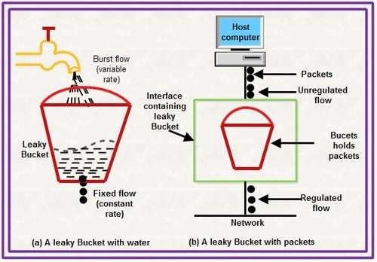
LEAKY BUCKET
Traffic shaping is about regulating the average rate (and burstiness) of data transmission.
LEAKY BUCKET
If a bucket has a small hole at the bottom, the water leaks from the bucket at a constant rate as long as there is water in the bucket. The rate at which the water leaks does not depend on the rate at which the water is input to the bucket unless the bucket is empty. The input rate can vary, but the output rate remains constant. Similarly, in networking, a technique called leaky bucket can smooth out bursty traffic. The idea is applied to packets. Each host is connected to the network by an interface containing a leaky bucket, that is, a finite internal queue. If a packet arrives at the queue when it is full, the packet is discarded.
Bursty chunks are stored in the bucket and sent out at an average rate. Arrival pattern of data is also depicted which can be bursty or fixed-rate.
The host is allowed to put one packet per clock tick onto the network. This can be enforced by the interface card or operating system. The packets should be of same size (e.g. ATM cells). With variable size, a fixed number of bytes of packets should be allowed.

Slide 33
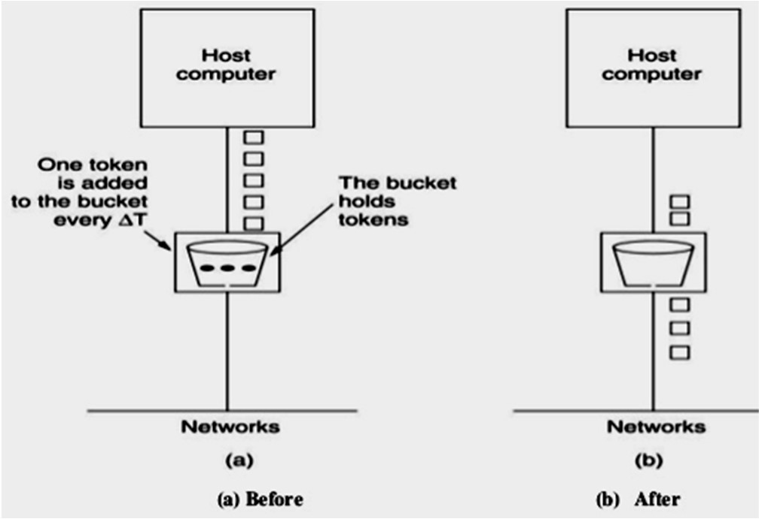
TOKEN BUCKET
The Leaky bucket algorithm enforces a rigid pattern at the average rate, no matter how bursty the traffic is.
For many applications, it is better to allow the output to speed up somewhat when large bursts arrive, so a more flexible algorithm is needed, preferably one that never loses data.
Token bucket is one such algorithm. In this algorithm, the leaky bucket holds
tokens, generated by a clock at the rate of
one token every ΔT sec.
For a packet to be transmitted, it must capture and destroy one token. Figure shows five packets queued with three tokens in the bucket, thus allowing three packets to move into the network at a time and remaining two packets waiting for more tokens to be generated.

Slide 34
Leaky Bucket | Token Bucket
Leaky bucket algorithm does not allow idle host to save up permission to send large burst later | Token bucket algorithm does allow saving, up to the maximum size of the bucket. This allows some burstiness in the output stream and giving faster response to sudden bursts of input
LBA discards packets when the bucket fills up | TBA throws away tokens when the bucket fills up but never discards packets
LBA doesn’t allow saving, a constant rate is maintained | TBA allows saving up tokens (permission) to send large bursts
LBA sends the packets at an average rate | TBA allows for large bursts to be sent faster by speeding up the output

